Slide 1
Workflow and Process Management
SharePoint 2007 Integration with Windows Workflow Foundation (WF)

Slide 2
Agenda
Windows Workflow Foundation (WF)
Understanding Workflow Templates
The MOSS Workflow Templates
Creating Workflow Associations
Starting and monitoring workflow instances
Creating Workflows with the SharePoint Designer

Slide 3
Process Management
Consultant enters timesheet
Account Manager Approves
Accounts Receivable bills client

Slide 4
Windows Workflow Foundation (WF)
What is the Windows Workflow Foundation?
Development platform for building reactive programs
Set of development tools integrated with Visual Studio
Runtime components that ship with.NET FX 3.0
Windows Workflow Foundation concepts
WF program
Workflow instance
Activities

Slide 5
Out-of-the-Box Workflows
 | Description
Approval | Routes the content for approval. You can setup this workflow as serial or parallel plus preset the approvers.
Collect Feedback | Routes the content for feedback. When the workflow completes all the feedback is sent to the originator of the workflow.
Collect Signatures | Rather than just sending content for approval, this workflow requires digital signatures on the content. This workflow requires the Office 2007 client and can only be initiated from a client application.
Disposition Approval | This workflow works with the records management capabilities of SharePoint. It allows you to manage document expiration and retention.
Group Approval (available in some languages) | To support hierarchical approvals, this workflow presents a hierarchical control to select the approvers and stamping rather than signatures for approval.
Translation Management | This workflow is used with the Web content management features of SharePoint to support a translation workflow for content to multiple languages.
Three-state (Included in Windows SharePoint Services; works with Issue Tracking list or any list with a Choice column with 3 values) | This workflow ships with Windows SharePoint Services and is a simple issue tracking workflow that shows status of active and resolved issues.

Slide 6
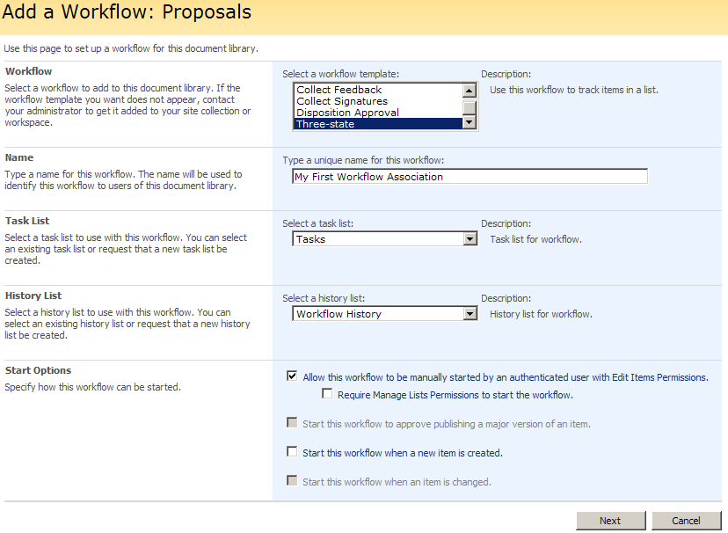
Creating a Workflow Association

Slide 7
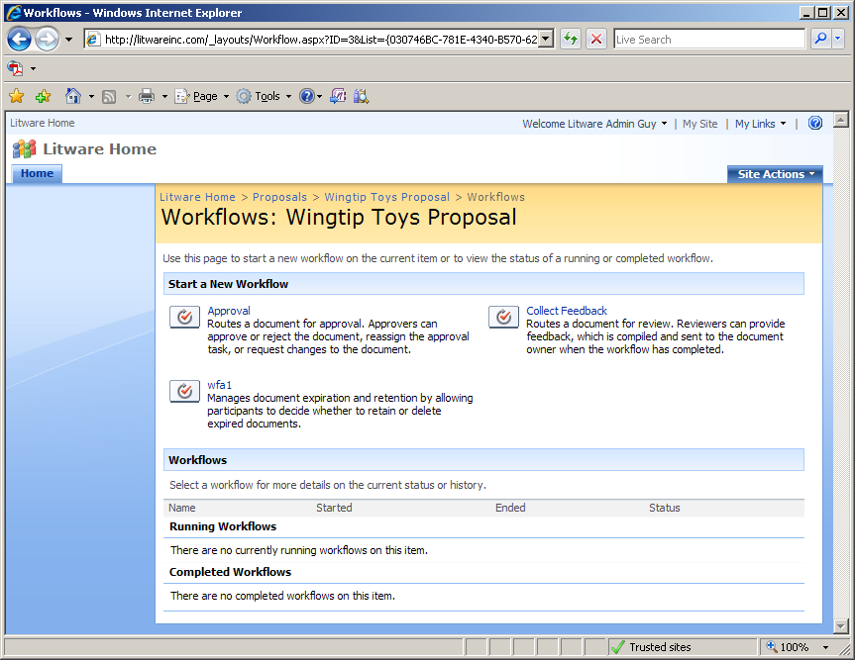
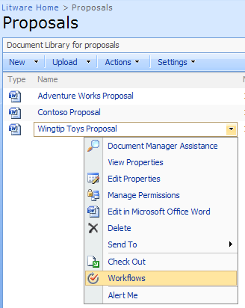
Starting a Workflow Instance
Users can manually start workflows

Slide 8
Automatically Start a Workflow
Most of the time to ease the burden on the users workflows are automatically started.
With SharePoint there are two options:
Item is Created
Item is Changed

Slide 9
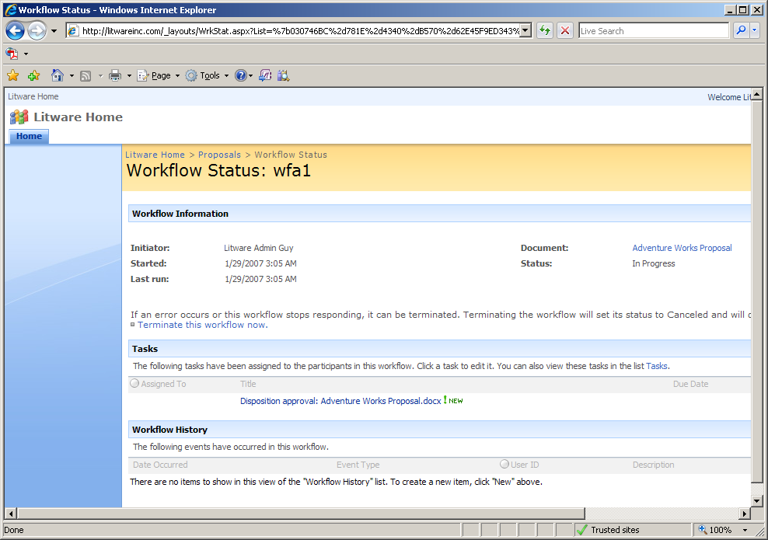
The Workflow Status Page
Any user can see the status of workflow instance

Slide 10
Workflows and SharePoint Designer
SPD supports creating workflow associations
SPD provides Workflow Designer
Offer “no code” approach to adding custom workflows
Advantages over development with Visual Studio
Much lower learning curve
Workflow created by user directly in live site
Disadvantages compared to development
Not as much flexibility
Very limited reuse

Slide 11
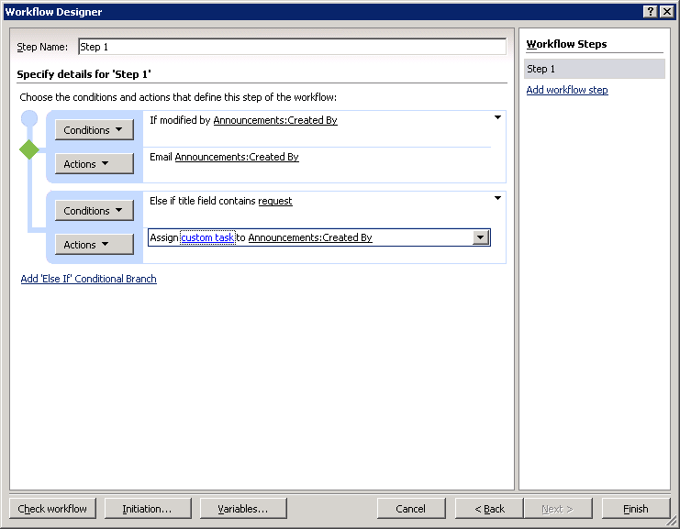
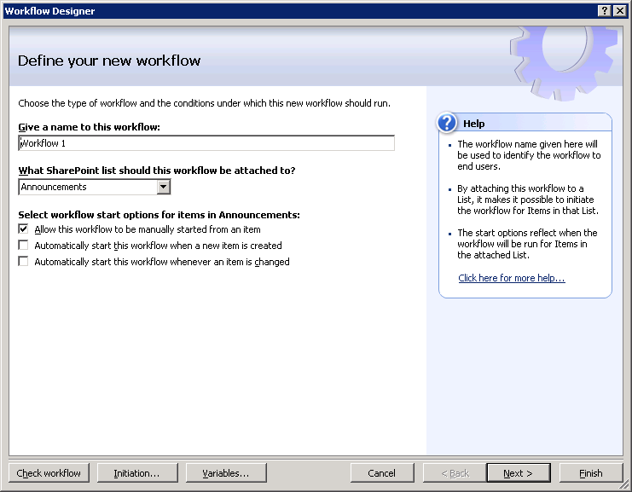
Creating Workflows with SPD
Notes:
5/24/2009 7:03 AM
11
© 2006 Microsoft Corporation. All rights reserved.
This presentation is for informational purposes only. Microsoft makes no warranties, express or implied, in this summary.

Slide 12
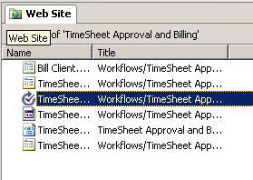
Editing SharePoint Designer Workflows
SharePoint Designer Workflows can only be edited with SharePoint Designer
Workflows may be deleted, paused, or resumed through the browser
Workflow reports are available in browser
Activity and Duration
Cancellation and Error
Notes:
SPD workflows can only be edited with SPD, you can stop and start instances in the Browser and view reports

Slide 13
SharePoint Designer or Visual Studio .NET?
 | SharePoint Designer | Visual Studio
Supported WF Hosts | WSS/SharePoint Server | WSS/SharePoint Server/Others
Development Model | Wizard-based | Graphical Designer
Types of Workflows Supported | Sequential | Sequential and State
Workflow Type | Markup only; markup file, rules and supporting files are not compiled | Markup with code behind compiled into an assembly
Code Behind | No | Yes
Activities | Built-in and use custom | Built-in, use and develop custom
Forms Technology | Auto-generated, customizable ASP.NET Forms | Design forms in any technology including ASP.NET or Microsoft Office InfoPath
Association | Associated automatically with a single list at design time. No other associations possible. | Can be associated with multiple content types, lists, and document libraries
Initiation | Initiation forms are supported | Initiation forms are supported
Modification | Cannot modify workflow using modification forms | Can modify workflows
Tasks | Supports custom task forms | Supports custom task forms
Deployment | Constructed in live environment | Must build package and deploy workflow using SharePoint feature technology
Debugging | No Debugging | Visual Studio Debugging

Slide 14
Summary
Windows Workflow Foundation (WF)
Understanding Workflow Templates
The MOSS Workflow Templates
Creating Workflow Associations
Starting and monitoring workflow instances
Creating Workflows with the SharePoint Designer

